Slide 1
NAME
Name of the students : Prudhivi Sai Ganesh,Vijay,Phanendra,Saranya
Problem statement title : Safest routing algorithm
Team name : Code lunatics
Team leader name : Prudhivi Sai Ganesh
Department : CTECH
SRM TECHNO HACKATHON 2023

Slide 2
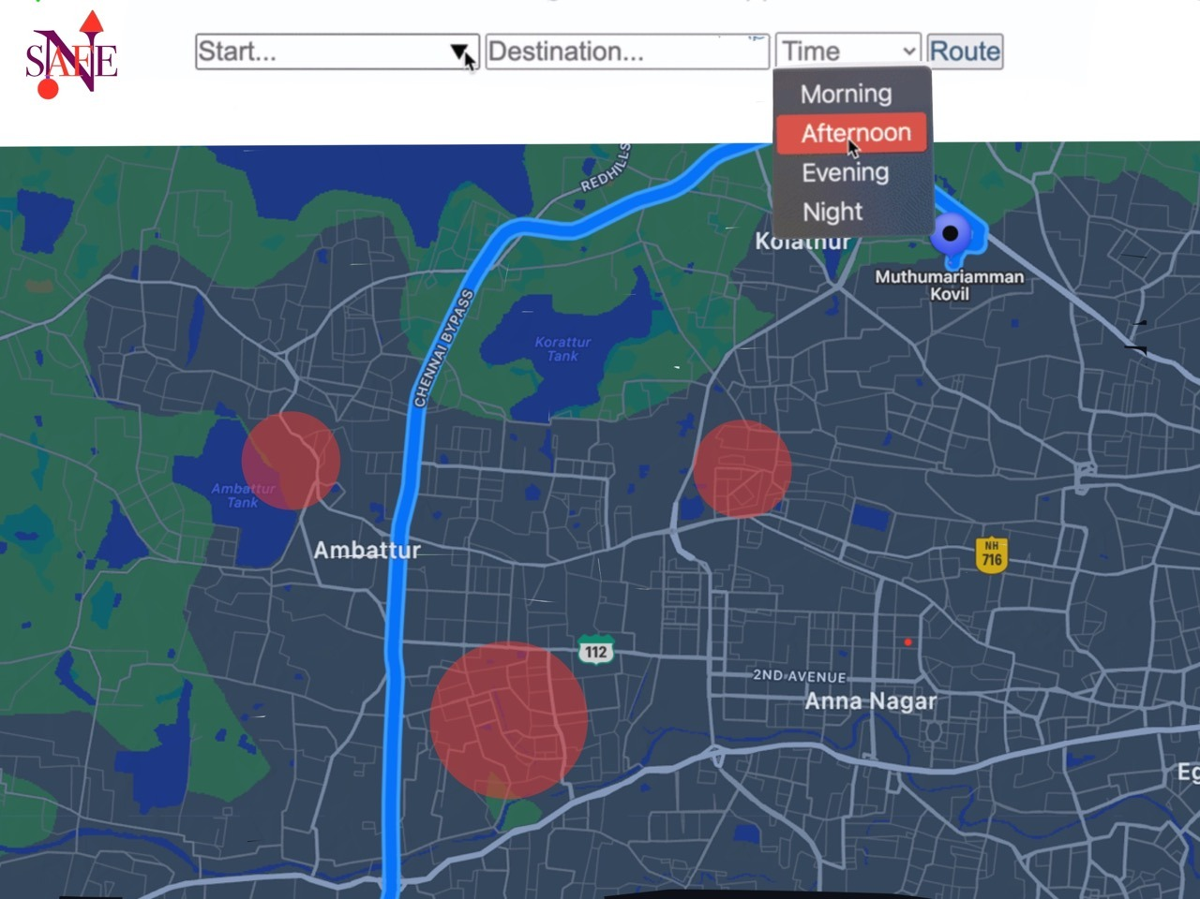
PROBLEM/PAIN POINT/OPPORTUNITY IDENTIFIED
Anyone who has ever been in an unfamiliar city knows the feeling of apprehension that comes with navigating on foot from point to point. You want to walk to your destination efficiently, but are also mindful of the desire to stay safe. Without the embedded knowledge of being a local, you don’t know which streets to avoid, particularly in the evenings.
For certain populations such as women, this problem feels particularly acute.
Existing solutions do little to address this major issue:
Conventional navigation apps like Google Maps don’t factor in pedestrian safety in their routing algorithms, often leading you through poorly lit alleyways to save on travel time
Searching online on forums like Reddit is both time-consuming and confusing, as you can get conflicting information, and don’t have a great way to integrate that into your navigation plans
Using online crime heat maps doesn’t give sufficient granularity - these tools often mark off entire neighborhoods, which isn’t useful.

Slide 3
START
FLOW DIAGRAM
Next simulation step
Direction people by the current path
Direction people by the newly defined path
Getting data from detectors on sections
Calculating the safest direction
Re-routing needed ?
CRIME RATE CALUCATION
YES
NO

Slide 4
BRIEFLY DESCRIBE THE SOLUTION/ TECHNOLOGY USED
Safe routing algorithm uses historical crime statistics, data from safety surveys, and clustering models to generate an intelligent overview of dangerous areas in a city.
A Heuristic is a technique to solve a problem faster than classic methods, or to find an approximate solution when classic methods cannot. This is a kind of a shortcut as we often trade one of optimality, completeness, accuracy, or precision for speed.
A Heuristic (or a heuristic function) takes a look at search algorithms. At each branching step, it evaluates the available information and makes a decision on which branch to follow.
Our heuristic function uses the historical crime data as the input and produces a heuristic value which helps the algorithm to find a better path
The Algorithm will then generate a route recommendation that is both efficient and safe. It also highlights risky areas in the map that are avoided.

Slide 5
Data set details
Scraping popular sources of crime and robbery data from the web to obtain a comprehensive understanding of the crime situation in different regions.
We collected data from different websites and converted most of the data into CSV files to feed to the algorithm
References:-
https://data.opencity.in/dataset/c894271b-0cbf-4a17-b4fe-96685e125f09/resource/bc01883a-c56f-433e-ba09-19b7b57f940b/download/tn_cr_statistics_2021.pdf
https://knoema.com/atlas/India/Tamil-Nadu

Slide 6
Pseudo code for SAFE Routing Algorithm
Input: a graph G, source node s, destination node d, a heuristic function h provided with crime data set
Output: shortest path with safe route from s to d
Set the distance of all nodes in G to infinity and mark them as unvisited.
Set the distance of s to 0 and mark it as visited.
Create an empty priority queue Q and add s to it.
While Q is not empty: a. Extract the node u with the smallest f(u) = g(u) + h(u)(with less crime rate) from Q, where g(u) is the distance from s to u and h(u) is the estimated distance from u to d. b. If u is the destination node d, return the path from s to d. c. For each neighbor v of u: i. If v is unvisited, mark it as visited. ii. Calculate the tentative distance from s to v as the distance from s to u plus the distance from u to v. iii. If the tentative distance is has the negligible the current distance of v, update the distance of v and set the parent of v to u. iv. Calculate f(v) = g(v) + h(v) and add v to Q.
If Q is empty and d has not been reached, there is no path from s to d.

Slide 7

COMPLETION STATUS
WE COMPLETED ABOUT 30 PERCENT OF THE PROJECT AS OUR HAS CLEAR ABSTRACT IDEA ABOUT THE PROJECT AND WE ARE IN THE IMPLEMENTATION STAGE OF THE PROJECT
AS A TEAM WE ARE ABLE TO LEARN NEW TECHNOLOGIES AND SHARE OUR DIFFERENT IDEAS WHICH BECOME A GOOD BASE FOR OUR PROJECT . LEARNING NEW THINGS ENHANCED OUR PEFORMANCE AS WE ARE ABLE TO IMPLEMENT CONCEPTS LIKE WEB SCRAPING , DATA ANALYSIS AND MANY MORE

Slide 8
THANK YOU

